Slide 1

AR Instrument
Tutorial System
Zach Dwyer
Sam Kline
Jay Patel
Changhee Son

Slide 2

Outline
Project Description
Use case diagram
Glossary/Terminology
Class Diagram
Goals
Non-functional requirements
Project Feasibility
Cost
Failure Scenarios
Prototype
Functional Requirements
Notes:
Jay

Slide 3

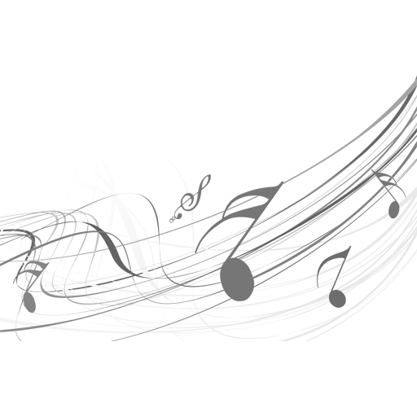
Project Description
Teach students how to play different instruments at a low cost
Help teachers easily assign learning material to many students
Help artists expose their music to other users to practice
Notes:
Jay
Two question
How many of you know how to play
How many of you would like to learn

Slide 4
Glossary/Terminology
Instrument Prop: Replica instrument that connects with our instrument sensor. Different variations of props will be used for different types of instruments.
Instrument Sensor: Allows communication between the Augmented Reality device and our instrument prop.
Song DataBase: A remote repository that stores all of our tutorial songs.
Notes:
Jay

Slide 5
Goals
More affordable than:
A real instrument
A real instructor
Accessible by many age groups
Building an intuitive and simplistic augmented reality interface
Easy for Artists to create and share original work using our system
Both student and teacher are able to compare and access the results easily
Notes:
Jay
Affordable: Develop an affordable product to allow customers interested in learning a real instrument, but may not have the funds to purchase a real instrument along with private lessons.
Age: This product will be available for a wide range of age groups allowing any age to begin to practice and play an instrument

Slide 6
Project Feasibility
Keep track of user’s progress while learning a new instrument
Each student will have a teacher to assist them in progressing with whatever musical instrument they might be interested in learning
Artist will have the ability to create original works using our AR application
Notes:
Changhee Son
Project Feasibility. While we were doing this project, we focus on these three things mainly. The first one is users are able to track their progress while learning a new instrument. The difference between the existed product with our project is UI.

Slide 7
Functional Requirements
Setting Instrument Sensor (Event Driven)
Boot System (Event Driven)
Sign up/Sign in (Choose User type) (Unwanted Behaviour)
Uploading Songs (For Artist) (Event Driven)
Assign Tutorials to Students (Teachers Only) (Event Driven)
Select difficulty Level (Only for Students) (State Driven)
Select Song from Tutorials (Event Driven)
Notes:
Sam

Slide 8
Functional Requirements
Students Play Song from Tutorials (Complex)
Students Pause/Exit Song from Tutorials (State Driven)
Students Resume Song from Tutorials (State Driven)
Tutorial Completion by Students (Event Driven)
Users view Profile (Event Driven)
Signing Out (State Driven)
Turning System off (State Driven)
Notes:
Sam

Slide 9
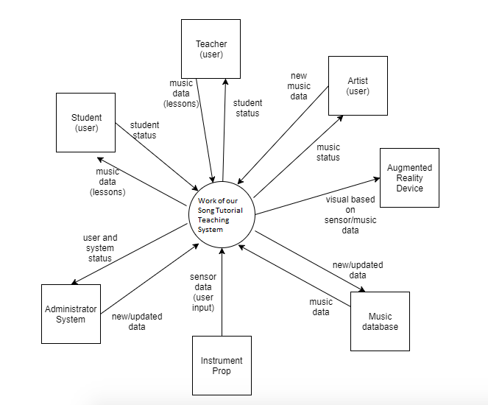
Context diagram
Notes:
Sam

Slide 10
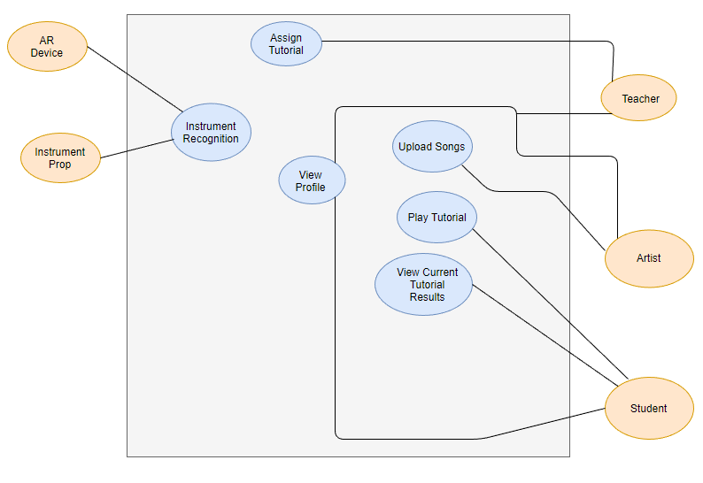
Use Case Diagram
Notes:
Zach
Here we view our use case diagram for our system. Here we are able to review our relevant actors for our systems. As seen on the left we can see our AR device and instrument prop actors communicating with our instrument recognition attribute.

Slide 11
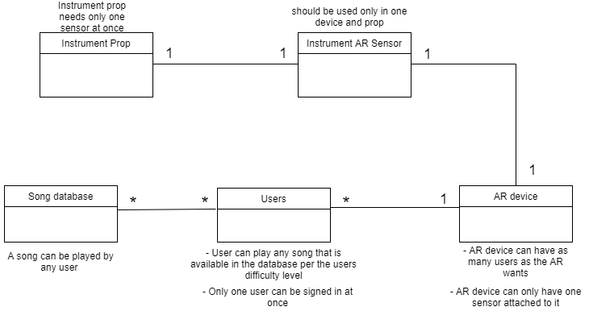
Class diagram
Notes:
Zach
Here we view our class diagram with our main components as discussed throughout our presentation. We have our instrument prop and instrument AR sensor which can only be connected with one another denoted by the one. There can also only be one instrument AR sensor connected to the AR device. Now our AR device is connected with our users which means any user who is eligble can access the AR device denoted by the astracs.

Slide 12
Non-functional requirements
Usability and Humanity
Easily usable by ages 8-50, difficulty level, no training needed
Performance
Boot time, response time, database capabilities, durability
Look and Feel
User interface, profile, sound quality
Operational and Environmental
Dry conditions, low volume
Notes:
Sam

Slide 13
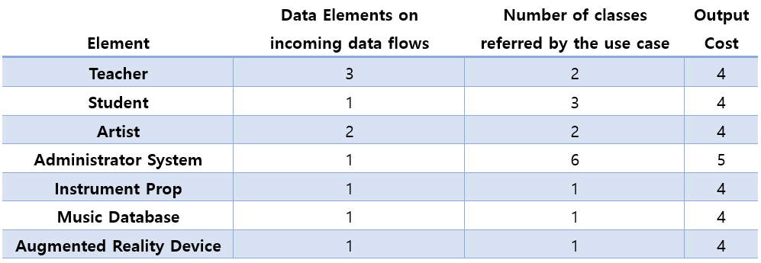
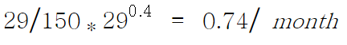
Output Cost
Total = 29 Jones principal :
Notes:
Changhee Son

Slide 14
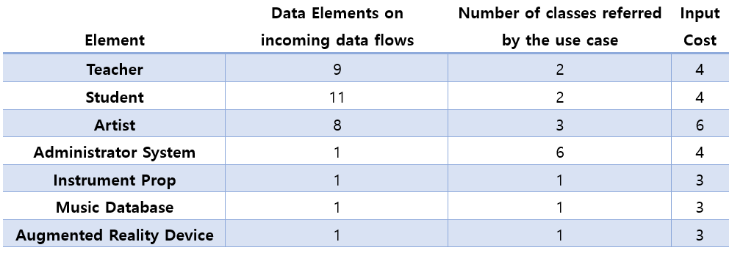
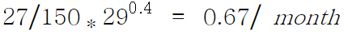
Input Cost
Total = 27 Jones principal :
Notes:
Changhee Son

Slide 15
Failure Scenarios
Instrument prop failures aka not working the way it should
- Ex) The Problem of The Sensor
Don’t have enough songs in the database for students to practice
Display issues
Show grading issues
Teacher to Student Feedback issues
Notes:
Changhee Son

Slide 16
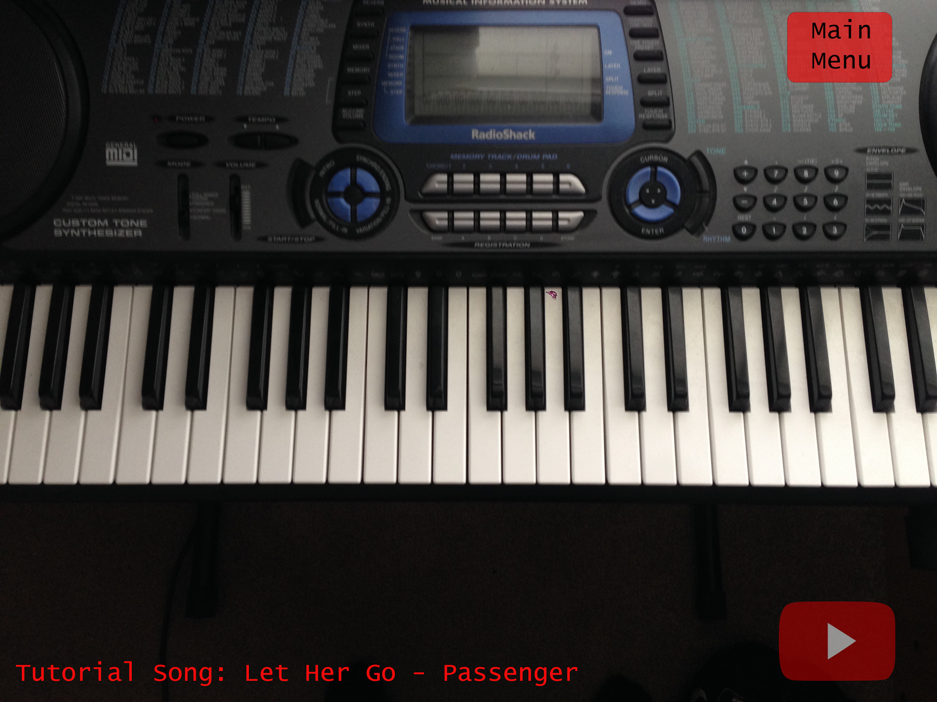
Prototype
Notes:
Zach

Slide 17
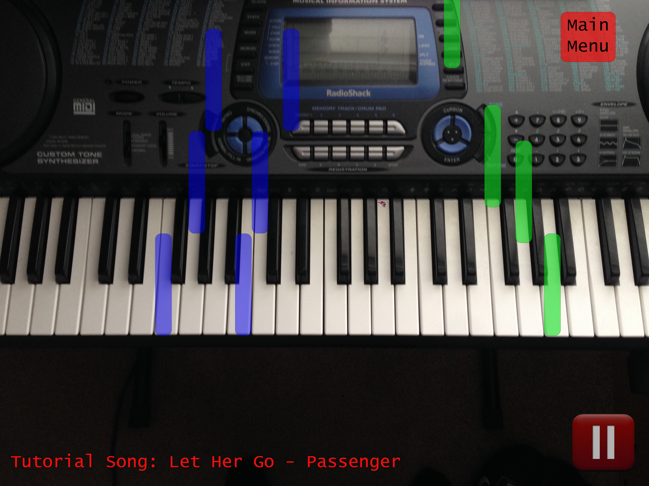
Prototype
Notes:
Zach

Slide 18
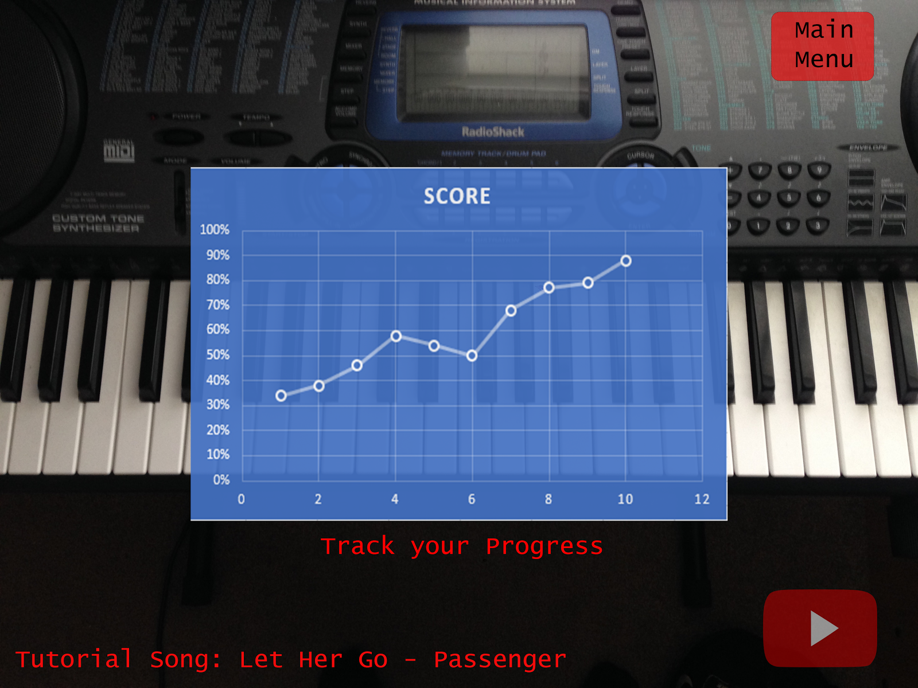
Prototype
Notes:
Zach

Slide 19
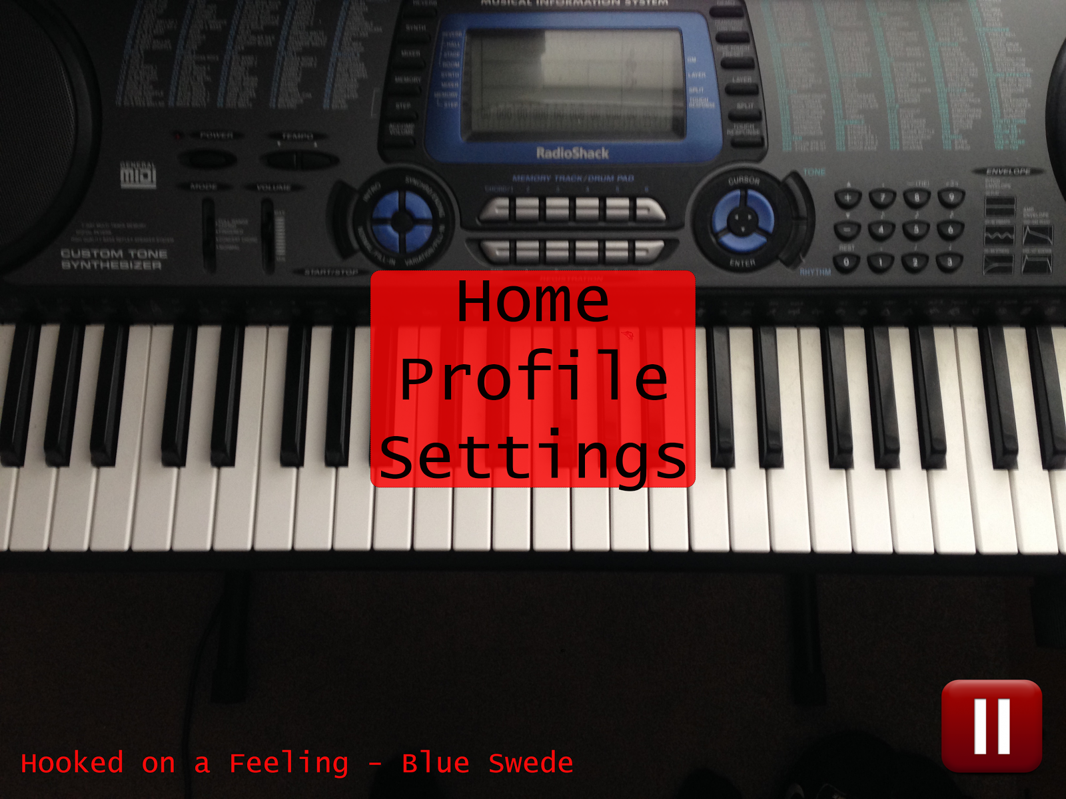
Prototype
Notes:
Zach

Slide 20
Q&A

Slide 21
Thank you

